Slide 1
Telemarketing d a Dying Industry?
Theodore Tay
DSI 3 – Capstone Presentation

Slide 2
Background
Prevailed as an effective sales strategy
Improvement in job opportunities
Poor calling etiquette
Scepticism from fraudulent transactions
Interruption to daily routine

Slide 3
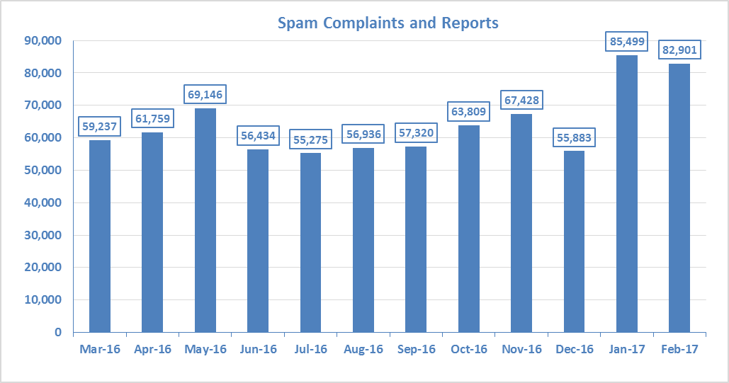
Australian Communications & Media Authority
Figure 1: Spam Act – Reports and complaints received per month

Slide 4

Aim
To provide valuable insights relating to telemarketing & customer behaviour.
To create a model to classify customers of a financial institution, based on their profiles, as subscribing to a term deposit or not.
Notes:
The main aim of the project is to be able to identify individuals who eventually subscribe to a term deposit – based on a telemarketing campaign.

Slide 5
Model Workflow
Step 1
Preliminary Modelling Techniques
Step 2
Re-sampling
Feature selection
Step 3
Remodelling
Logistic regression
SVM etc.
(All of the above with Grid Search)
Logistic regression
K-nearest neighbours

Slide 6
Model of Choice: Support Vector Machine
Applicable to linearly or non-linearly
separable (classification) classes
Baseline accuracy 0.538
Prediction accuracy 0.846
Classification report

Slide 7

Features of interest?
Employee variability rate
Duration of phone call
Previous participation in a campaign
Success of previous campaigns
Month of contact

Slide 8
Features of interest?
Employee variability rate
Duration of phone call
Previous participation in a campaign
Success of previous campaigns
Month of contact

Slide 9

Summary
Improve workplace efficiency
Campaign success rate
Customer satisfaction
Retain revenue stream from niche customer segment

Slide 10
Thank you

Slide 11
Limitations

